Slide 1
Getting camel & First try at it
COURSEWARE

Slide 2
Prerequisites
Java
Maven
ActiveMQ
IDE
Notes:
Everything we’ll need will just be dependencies maven will download for the project.

Slide 3
Downloading the camel library
You can download it from http://camel.apache.org/download.html if you will be downloading it, select the appropriate distribution for your OS.
We’ll mainly use 2.20.1 version.
Notes:
This is not needed and is just for explanation purposes if you wanted to take a look at the documentation or other.

Slide 4
What’s inside the camel library
doc - Contains the Camel manual in HTML format.
examples - Includes 97 Camel examples.
lib - Contains all Camel libraries.
LICENSE.txt - Contains the license of the Camel distribution.
NOTICE.txt - Contains copyright information about the third-party dependencies included in the Camel distribution.
README.txt - Contains a short intro to Camel and a list of helpful links to get new users up and running.

Slide 5
First try at Camel
We’ll now take a quick look at the example of how we would copy the files using Camel and a Java way of doing it.
Notes:
filecopyjava
filecopycamel

Slide 6
Exercise
I will send out the handout which contains instructions of how to implement the previous example.
Carefully first read the instructions and then attempt it.

Slide 7
Camel’s message model
Camel uses two abstractions for modeling messages:
org.apache.camel.Message - The fundamental entity containing the data being carried and routed in Camel.
org.apache.camel.Exchange - The Camel abstraction for an exchange of messages. This exchange of messages has an in message, and as a reply, an out message.

Slide 8

Message
Messages are the entities used by systems to communicate with each other when using messaging channels. Messages flow in one direction, from a sender to a receiver.

Slide 9
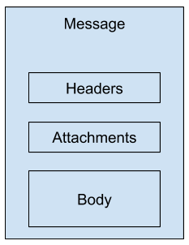
Message structure
Messages have a body (a payload), headers (optional), and optional attachments.
Notes:
Messages are uniquely identified with an identifier of type java.lang.String. The identifier’s uniqueness is enforced and guaranteed by the message creator, it’s protocol dependent, and it doesn’t have a guaranteed format. For protocols that don’t define a unique message identification scheme, Camel uses its own ID generator.

Slide 10
Message header
Headers are values associated with the message, they are name-value pairs and can contain:
sender identifiers
content encoding
authentication information
The name is a unique, case-insensitive string.
Camel imposes no constraints on: Type of the headers, Size of headers or Number of headers.
Headers are stored as a map within the message.
A message can also have optional attachments, which are typically used for the web service and email components.

Slide 11
Message body
Message body can store any kind of content and any size
Application designer makes sure that the receiver can understand the content of the message.
When message types are different between sender and receiver, the conversion is done by camel automatically

Slide 12
Exchange
Exchange in Camel is the message’s container during routing
Exchange also provides support for the various types of interactions between systems
The Camel exchange holds a pattern property:
InOnly - A one-way message
InOut - A request-response message.
Exchange also has components like:
Exchange ID - unique ID generated by camel
Exception - if error happens during routing
MEP - a pattern that tells InOnly or InOut
Properties - Similar to message headers, but they last for the duration of the entire exchange

Slide 13
Routing Engine
The engine that moves the messages around
Isn’t exposed to the developer
Does all the heavy lifting for you and ensures messages are routed correctly

Slide 14
Routes
In simplest way it’s a chain of processors. Each route in Camel has a unique identifier that’s used for logging, debugging, monitoring, and starting and stopping routes. Routes also have exactly one input source for messages, so they’re effectively tied to an input endpoint. There’s syntactic sugar for having multiple inputs to a single route.
from("jms:queue:A", "jms:queue:B", "jms:queue:C").to("jms:queue:D");
Under the hood it would be translated as:
from("jms:queue:A").to("jms:queue:D");
from("jms:queue:B").to("jms:queue:D");
from("jms:queue:C").to("jms:queue:D");
Notes:
It’s not suggested to do it in the first example even though it’s possible.

Slide 15
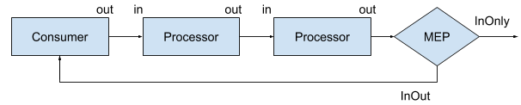
Processor
Processor is a concept able of using, creating, or modifying an incoming exchange. During routing, exchanges flow from one processor to another.
Notes:
A route first starts with a consumer (think “from” in the DSL) that populates the initial exchange. At each processor step, the out message from the previous step is the in message of the next. At the end of a route, the MEP of the exchange determines whether a reply needs to be sent back to the caller of the route. If the MEP is InOnly ,
no reply will be sent back. If it’s InOut, Camel will take the out message from the last step and return it.

Slide 16
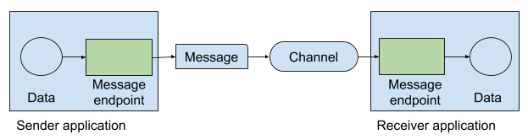
Endpoint
An endpoint is the Camel abstraction that models the end of a channel through which a system can send or receive messages.
Notes:
In Camel, you configure endpoints by using URIs, such as file:data?delay=5000 , and you also refer to endpoints this way. At runtime, Camel looks up an endpoint based on the URI notation.

Slide 17
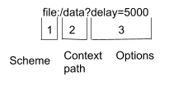
Endpoint
In Camel, you configure endpoints by using URIs, such as file:data?delay=5000 , and you also refer to endpoints this way. At runtime, Camel looks up an endpoint based on the URI notation.
The scheme, denotes which Camel component handles that type of endpoint.
The context path data, tells FileComponent that the starting folder is data.
The option, delay=5000 indicates that files should be polled at a 5-second interval.

Slide 18
Consumer
A consumer is the service that receives messages produced by some external system, wraps them in an exchange, and sends them to be processed.
Camel has two kinds of consumers: event-driven consumers and polling consumers. The differences between these consumers are important, because they help solve different problems.

Slide 19
Consumer types
Event-driven consumer remains idle until a message arrives, at which point it wakes up and consumes the message.
Polling consumer actively checks for new messages. In contrast to the event-driven consumer, the polling consumer actively goes and fetches messages from a particular source, such as an FTP server.

Slide 20
Thank you
QA HOPES YOU ENJOYED YOUR COURSE,
AS MUCH AS WE ENJOYED TEACHING YOU.

